Slide 1
ENERGY
Prepared by Dr. Pushpendra rai
Modified by Dr. Druman Utekar

Slide 2
Energy
The sun, directly or indirectly, is the source of all the energy available on Earth. Energy is essential to life and all living organisms.
Energy is a conserved quantity and the law of conservation of energy states that energy can neither be created nor destroyed but can only be converted from one form to another. The SI unit of energy is Joule.

Slide 3
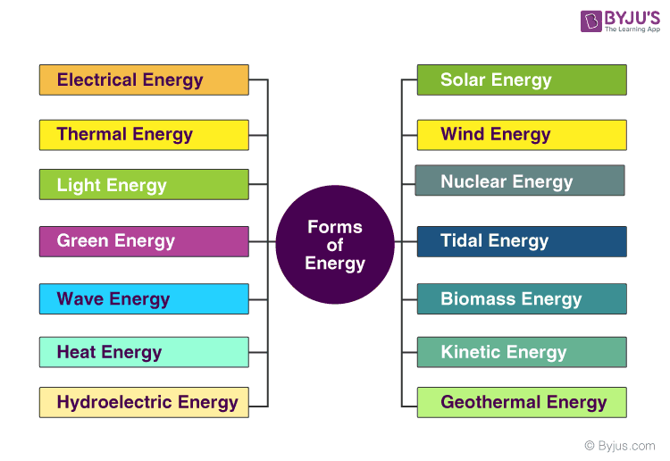
Types of Energy

Slide 4
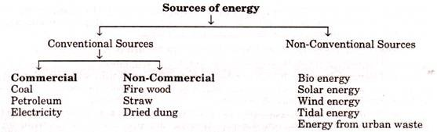
Classification of Energy

Slide 5
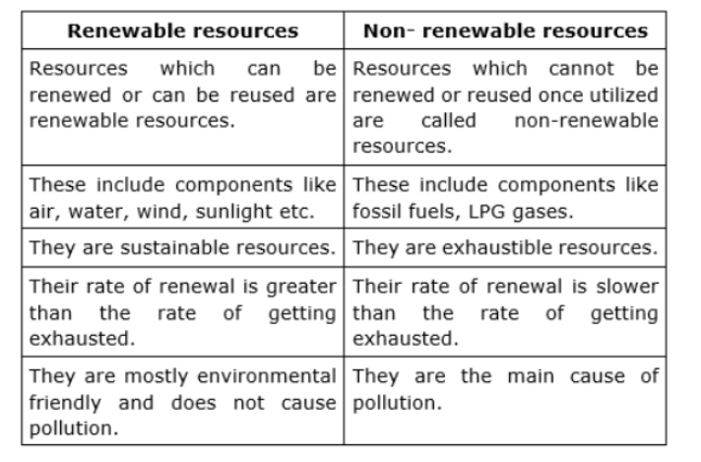
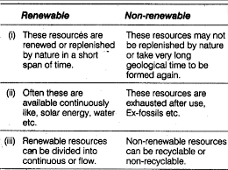
Distinction: Conventional (non-renewable) and nonconventional energy (renewable) sources.

Slide 6
Solar Energy
The electromagnetic radiation from sun is commonly known as solar energy. These radiations are
resulted from thermo nuclear fusion reaction on the surface of sun. All the radiation from the sun is not
in the same wavelength range. Almost 92% lie in the range of 315 nm to 1400nm. The estimated
amount of solar flux reaching the atmosphere of earth is approximately 1400W/m2min.and that of heat
equivalent is 2.68 X 10²⁴ J/Year. The eco system of earth utilizes about 0.2-0.5 % of total amount of
solar energy received. It indicates clearly that large amount solar energy get wasted, which otherwise
can be immense use for satisfying needs of humans.
Advantage of solar energy:
1. It is non-polluting and non-depleting source of energy.
2. It is renewable source of energy.
3. It is available abundantly.
In spite of these advantages, the use of solar energy in large scale is still not in practice, due to
following reasons,
1. Non availability of intense light in all areas throughout year
2. Difficulties faced in economic collection and conversion of solar energy into other forms of
energy such as electricity.
The solar energy has been successfully used in following purpose
i) Heating: Used for water and space heating in colder countries.
ii) Electricity: Using solar energy electric energy can be generated.

Slide 7
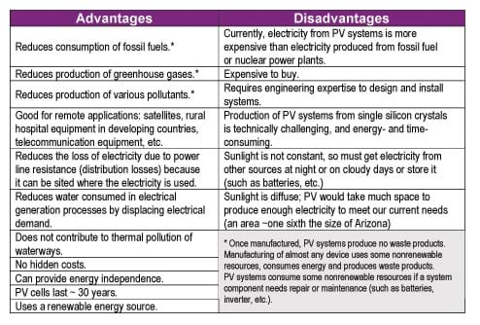
Advantages and Disadvantages

Slide 8
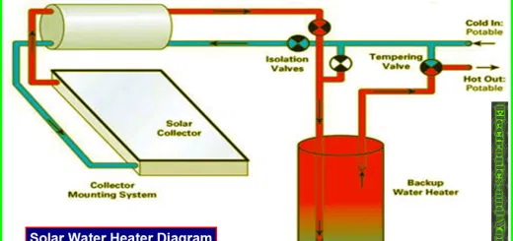
Solar Water Heater

Slide 9
Flat Plate Collector:
The device works on the principle of black body in which heat absorbing capacity and tendency of a black surface is utilized to achieve benefits for human.
Construction:
These are the main components of a typical flat-plate solar collector:
• Black surface - absorbent of the incident solar energy
• Glazing cover - a transparent layer that transmits radiation to the absorber, but prevents radiative
and convective heat loss from the surface
• Tubes containing heating fluid to transfer the heat from the collector
• Support structure to protect the components and hold them in place
• Insulation covering sides and bottom of the collector to reduce heat losses
Application
Some advantages of the flat-plate collectors are that they are: Easy to manufacture
• Low cost, Collect both beam and diffuse radiation
• Permanently fixed (no sophisticated positioning or tracking equipment is required)
• Little maintenance

Slide 10
PHOTO VOTAIC CELL (SOLAR CELL) A conventional solar cell structure is shown in figure:
A solar cell is a carefully designed semiconductor diode. It uses semiconductors like silicon to absorb light, and then converts a portion of the absorbed photon energy into electrical energy by generating charge carriers (electrons and holes).

Slide 11
Construction: A silicon photovoltaic cell consists of a phosphorus-doped (n-type) layer on boron-doped (p-type) silicon, forming a p-n junction. A metallic grid allows light to reach the semiconductor and an anti-reflective layer increases light transmission.
Working: When light hits a photovoltaic cell, photons are absorbed, creating electron-hole pairs. Electrons collect at the n-type end and holes at the p-type end. Connecting these ends through a conductor creates a current. The cell’s output depends on its efficiency, size, and sunlight intensity. Cells are connected in series or parallel to increase power. A group of connected cells is a module, and an array is a complete power unit made of modules.

Slide 12
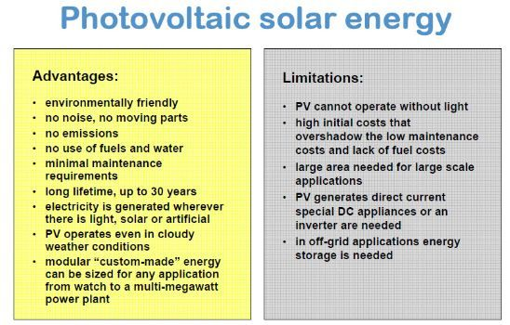
Advantages & Disadvantages

Slide 13
Fuel cells
H2-O2 fuel cells-Self Study

Slide 14
Fuels
Fuels can be defined as substances which undergo combustion in the presence of air to produce a large amount of heat that can be used economically for domestic and industrial purpose.
Examples, Wood, Coal, Kerosene, Petrol

Slide 15
Classification of chemical fuels
Based on the origin: i) Primary or natural fuels
ii) Secondary or artificial or derived fuels
B) Based on Physical State: i) Solid Fuels
ii) Liquid Fuels
iii) Gaseous Fuels
C) Based on Chemical Nature
Organic eg. Vegetable fuel, coal
Inorganic eg. Iron Pyrites
Nuclear Fuels eg. Uranium oxide

Slide 16
Characteristic Properties of Fuels
Fuels are characterized by testing certain physical and chemical properties.
Calorific Value should be as high as possible.
Ignition temperature-Moderate
Flame temperature should be as high as possible.
Flash and Fire point should be as high as possible.
Aniline point should be low.
Cloud and Pour point should be as low as possible.
Viscosity should be adequate.
Coke number should be as high as possible.
Moisture content-as low as possible.
Volatile matter as low as possible.
Ash content should be absent.
Easy risk free transport should be possible.
Storage space-ideally fuel should occupy small space.
Air requirement- adequate
Harmless products should be produced on combustion.

Slide 17
Calorific Value
Calorific value is defined as the number of parts of water which gets heated through 1°C by the heat evolved by the complete combustion of one unit weight of fuel( unit volume of gaseous fuels) under the conditions such as
Whole of heat evolved is absorbed by water.
The products formed leave the system at atmospheric temperature and pressure.
It is the most important property of fuel.

Slide 18
Units of calorific value
B.T.U. (British Thermal Unit)
A British thermal unit may be defined as the heat required to raise the temperature of one pound of water from 60°F to 61°F.
2) K.C.U. (Kilogram Centigrade Unit)
The calorie, a unit of heat may be defined as, the heat required to raise the temperature of one Kg of water from 15°C to 16°C.
Correlation between BTU and KCU:
1BTU = 0.252KCal =252Cal
1KCal = 3.968 BTU
3) C.H.U. (Centigrade Heat Unit)
The calorific value can also be expressed as centigrade heat unit (C.H.U.)., which is the amount of heat required to raise temperature of one pound of water through one degree centigrade.

Slide 19
1) High Calorific value (HCV) or Gross Calorific value (GCV):
High calorific value may be defined as the total amount of heat produced when one unit of the fuel has been burnt completely and the products of combustion have been cooled to 16°C or 60°F.
2) Low calorific value( LCV) or Net Calorific value (NCV)
Low calorific value may be defined as the net heat produced when unit mass or volume of fuel is completely burnt and products are allowed to escape.
NCV or LCV = GCV (HCV) – Latent Heat of water formed
= GCV(HCV) – Mass of hydrogen x 9 x Latent heat of steam
= GCV(HCV) – 0.09 x %H x 587
Because 1 part by weight of hydrogen produces 9 parts (1+8) by mass of water.

Slide 20
Dulong Formula
The calorific value of fuels is determined theoretically by Dulong formula or I.A. Davies formula.
It is expressed as
Q = 1/100 [ 8080 x C + 34500 x (H – O/8) + 2240 x S]
Where, Q = Calorific value in KCU/Kg
C = % of carbon
H = % of hydrogen
O = % of oxygen
S = % of Sulphur
Dulong formula for HCV & LCV
HCV = 1/100 [8080 x C + 34500 x (H – O/8) + 2240 x S]
LCV = HCV –[ 9/100 x %H x 587]
Experimentally calorific value of solid and liquid fuel is determined using Bomb Calorimeter.

Slide 21
Numerical 1: A sample of coal contains C = 55%, O = 28%, H =7%, S = 0.7%, N =0.2%, Ash = 0.2%. Calculate the GCV and NCV.
Sol:
GCV = 1/100[ 8080C + 34500(H-O/8) + 2240S]
= 1/100 [ 8080x55 + 34500(7-28/8) + 2240 x 0.7]
= 5667 Kcal/Kg
NCV = HCV – 0.09 x % H x 587
= 5667 – 0.09 x 7 x 587
= 5297.19Kcal/Kg
Numerical 2: A sample of coal has following composition C = 70%, O = 8%, H = 10%, N =3%, S = 2%, Ash = 7%. Calculate HCV and GCV.
Numerical 3: A sample of coal contains C = 61% , O = 32%, S = 0.5%, N = 0.2% and Ash = 0.3%. If NCV of coal is 5313.02KCal/Kg. Calculate % H and GCV.
GCV =1/100[8080C + 34500(H-O/8) + 2240S]----i)
NCV = GCV -0.09x%Hx587
GCV = NCV + 0.09x%H x587-------ii)
1/100[8080C + 34500(H-O/8) + 2240S) = NCV + 0.09x%Hx587

Slide 22
Numerical 3: A sample of coal contains C = 61% , O = 32%, S = 0.5%, N = 0.2% and Ash = 0.3%. If NCV of coal is 5313.02KCal/Kg. Calculate % H and GCV.
GCV =1/100[8080C + 34500(H-O/8) + 2240S]----i)
NCV = GCV -0.09x%Hx587
GCV = NCV + 0.09x%H x587-------ii)
1/100[8080C + 34500(H-O/8) + 2240S) = NCV + 0.09x%Hx587

Slide 23
Numerical 3: A sample of coal contains C = 70% , O = 25%, S = 1%, N = 1% and Ash = 0.5%. If NCV of coal is 5200KCal/Kg. Calculate % H and GCV.
GCV =80.80x70 + 345(H-25/8) + 22.40x1]----i)
=5656+345H-1078.125+22.4
= 4600+345H
NCV = GCV - 0.09x%Hx587
GCV = 5200 + 0.09x%H x587
= 5200 + 52.83H-------ii)
4600.275+345H = 5200 + 52.83H
345H- 52.83H = 5200-4600.275
292.17H = 599.725
H = 2.05%
GCV= 5308.44Kcal/Kg

Slide 24
Coal
Purpose of Analysis of Coal
To decide price of coal
To determine quality
To specify use of coal for a particular purpose.
To calculate theoretical calorific value of coal.
To calculate air requirement for complete combustion of coal and design the furnace fire box suitably.

Slide 25
Types of Analysis of Coal
Proximate Analysis
% Moisture
% Volatile Matter
% Ash
Fixed Carbon
B) Ultimate Analysis
% Carbon and % Hydrogen
% Nitrogen
% Sulphur
% Ash

Slide 26
Proximate Analysis of Coal
Proximate analysis is the study or analysis of coal sample in which
% Moisture b) % VM c) % Ash d) % Fixed Carbon are found out.
a) % Moisture
A known weight of powdered and air dried coal sample is taken in a crucible and it is places in an oven for 1hr at 110°C. Then the coal is cooled in a desiccator and weighed out. If the initial weight of the coal is W gms and final weight is W1 gms.
Then the loss in weight (W-W1) corresponds to moisture in coal.
% Moisture = Loss in weight x 100 = (W-W1) x 100
Weight of coal sample W

Slide 27
b) % Volatile Matter
Moisture free coal left in the crucible in first experiment W1 is covered with a lid loosely. Then it is heated at 925°C in a muffle furnace for 7min.
The crucible is taken out and cooled in a desiccator. Then it is weighed (W2 gms) .
% Volatile matter = weight of volatile matter x 100 = (W1-W2) x100
Weight of coal sample W
c) % Ash
The residual coal in the above experiments is heated and burnt in an open crucible at above 750°C for half hour.
The coal gets burnt. The ash left in crucible is cooled in a desiccator and weighed W3 gms.
% Ash = weight of ash x 100 = W3 x 100
Weight of coal W
d) % Fixed Carbon:
It is found by calculations
%FC = 100-[% moisture + % VM + % Ash)

Slide 28
Significance or Importance of proximate analysis
Moisture
It decreases calorific value of coal largely as it does not burn and takes away heat in the form of latent heat.
It increases ignition point of coal.
Hence a coal with lower moisture % is better quality.
b) Volatile matter
It decreases calorific value of coal.
It elongates flame and decreases flame temperature.
It form smoke and pollute air.
However the coals containing 15-25% of VM on carbonization gives coke oven gas which is source of various organic aromatic chemicals.
Such coal have good coaking property and coke can be obtained from the coals.
Overall regarding burning of coal the coal with lesser VM is better quality coal.
c) Ash
It reduces calorific value of coal as ash is non-burning part in coal.
Ash disposal is a problem.
Ash fuses to form clinker at high temperature obstructing the air supply of coal burning furnace.
Hence lesser the % ash better is the quality of coal.
d) Fixed carbon
Carbon is the burning part in coal and higher the fixed carbon higher is calorific value.
Hence a good quality coal contains high fixed carbon percentage.

Slide 29
Numerical 1: A sample of coal was analyzed for content of moisture, volatile matter & ash. From the following data, calculate the percentage of the above quantities.
i) weight of coal taken = 2.5g
ii) weight of coal after heating at 110°C = 2.365g
iii) weight of coal after heating at covered crucible at 950°C = 1.165g
iv) constant weight obtained at the end of the experiment = 0.460g
Sol:
% Moisture = (W-W1) x 100 = ( 2.5-2.365 )x 100 =5.4%
W 2.5
b) % volatile Matter = (W1-W2)x 100 = (2.365-1.165) x 100 = 48%
W 2.5
c) % Ash = W3 x 100 = 0.460 x 100 = 18.4%
W 2.5
d) % Fixed Carbon = 100 – [% moisture + % VM + % Ash]
= 100 – [5.4 + 48+ 18.4] = 28.2%

Slide 30
Ultimate Analysis
1) Carbon and 2) hydrogen:
About 1-2 g of accurately weighed coal sample is burnt in a current of oxygen in a combustion apparatus. C and H of the coal are converted into CO2 and H2O respectively. The gaseous products of combustion are absorbed respectively in KOH and CaCl2 tubes of known weights.
The increase in weights of these are then determined.
C + O2 ----->CO2
2H2 + O2-----> 2H2O
KOH + CO2-----> K2CO3 + H2O
CaCl2 + 7 H2O-----> CaCl₂.7 H2O

Slide 31
3) Nitrogen by Kjeldahl’s Method: About 1 g of accurately weighed powdered 'coal is heated with concentrated H2SO4 along-with K2SO4(catalyst) in a long-necked flask(called Kjeldahl’s flask). After the solution becomes clear, it is treated with excess of KOH and the liberated ammonia is distilled over and absorbed in a known volume of standard acid solution. The unused acid is then determined by back titration with standard KOH solution. From the volume of acid used by ammonia liberated, the percentage of N in coal is calculated as:

Slide 34
Numerical 1: 0.2g of Coal Sample is accurately weighed and is burnt in a combustion apparatus. The gaseous products of combustion are absorbed in potash bulb and calcium chloride tubes of known weights. The increase in weight of potash bulb and CaCl2 tube are 0.66g and 0.08g respectively. Calculate the % C and % H in coal sample.
Numerical 2: 3g of coal was heated in Kjeldahls flask and NH3 gas evolved was absorbed in 40mL of 0.5N HCl. After absorption the excess acid required 18.5mL of 0.5N KOH for exact neutralization. 2.3g of coal sample in quantitative analysis gave 0.35g BaSO4. Calculate % of N and S in coal sample.
Sol: Volume of NH3 consumed by 0.5N HCl is in terms of 0.5N KOH
40ml of 0.5N HCl = 40mL of 0.5N KOH---assumed---V1___blank
Unreacted acid = 18.5ml of 0.5N KOH----V2____back titration
Vol of acid reacted with absorbed NH3 in term of 0.5N KOH = 40 – 18.5ml = 21.5mL
% N = volume of acid consumed(V1-V2) x N KOH x 1.4
weight of coal sample
% S = Wt. of BaSO4 formed x 32x 100
wt. of coal sample x 233
Numerical 3: 2.5 g of coal was heated in Kjeldahls flask and NH3 gas evolved was absorbed in 40mL of 0.5 N HCl. After absorption the excess acid required 8.5mL of 0.25N KOH for exact neutralization.
Sol:
Blank titration = 40mL of 0.5N HCl = 40mL of 0.5N KOH
Back titration = 8.5mL of 0.25N KOH = __4.25__ml of 0.5N KOH----n1v1=n2v2

Slide 36
l Hydrocarbon as Fuel
Hydrocarbons are organic compounds composed primarily of hydrogen and carbon atoms. Hydrocarbons are the primary constituents of fossil fuels, which have been the backbone of modern civilization's energy consumption for decades. They power vehicles, aircraft, ships, and provide heating and electricity for residential, commercial, and industrial purposes.
Characteristics of Hydrocarbons as Fuel:
Energy-Dense: Hydrocarbons are highly energy-dense compounds, making them efficient sources of fuel. When burned, they release significant amounts of energy, which can be harnessed for various purposes like transportation, electricity generation, heating, and industrial processes.
Various Forms: Hydrocarbons exist in different forms, including solid (like coal), liquid (such as crude oil and its derivatives like gasoline, diesel, and kerosene), and gaseous (like natural gas). This diversity allows for flexibility in their applications.
Ease of Transport and Storage: Liquid hydrocarbons, such as gasoline and diesel, are relatively easy to transport and store compared to other forms of energy. They have high energy density per unit volume, allowing for convenient storage and transportation via pipelines, tankers, and fuel storage facilities.

Slide 37
Environmental and Societal Impact:
The biggest challenge modern industrial society is facing today is the decline and exhaustion of the fossil energy resources. The primary sources of energy that power our civilization are those fossil fuels.
The combustion of hydrocarbons releases carbon dioxide (CO2), a greenhouse gas contributing to climate change. Additionally, incomplete combustion can result in emissions of harmful pollutants like carbon monoxide (CO), nitrogen oxides (NOx), and particulate matter, which contribute to air pollution and health issues.
Therefore continued use of hydrocarbon derived from fossils-sourced fuels is now widely recognized as unsustainable because of depleting supplies and increasing demand.

Slide 38
Future Trends and Alternatives:
Shift Towards Renewable Energy: Increasing concerns about climate change and environmental impact are driving efforts to transition away from fossil fuels. Renewables like power alcohol and biodiesel, fuel cell are gaining prominence due to their lower environmental impact and potential for sustainable energy generation.
Technological Innovations: Ongoing research and development aim to improve the efficiency of hydrocarbon-based fuel production and reduce their environmental footprint.

Slide 39
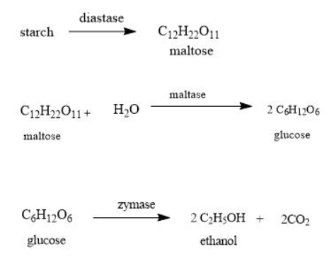
Power alcohol
Power alcohol, also known as ethanol or ethyl alcohol, is a type of renewable biofuel derived from plant materials such as sugarcane, corn, barley, wheat, or cellulose-rich materials like wood chips and agricultural residues.
Production:
Fermentation: Power alcohol is primarily produced through a process called fermentation, where sugars present in plant materials are converted into ethanol by the action of yeast or bacteria in the absence of oxygen.

Slide 40
Advantages
Reduced Greenhouse Gas Emissions: When compared to fossil fuels, ethanol generally produces lower net carbon dioxide emissions, contributing to mitigating climate change.
Domestic Production: Many countries aim to promote ethanol production from locally grown crops, reducing dependence on imported oil and enhancing energy security.
Fuel Properties: Ethanol has high octane ratings and can be used as a blending component in gasoline to enhance its octane level and reduce emissions.
Renewable and Environmentally Friendly: Power alcohol is considered a renewable fuel as it is derived from plant matter that can be grown and harvested repeatedly. It is also relatively cleaner burning compared to fossil fuels, emitting fewer greenhouse gases and pollutants like carbon monoxide and particulate matter.

Slide 41
Limitations
Lower Energy Density: Ethanol has a lower energy density ( calorific value 7000 Kcal/Kg as compared to gasoline ( 12000 Kcal /Kg), resulting in decreased fuel efficiency when used as a standalone fuel. Vehicles running on ethanol may experience reduced mileage compared to gasoline-powered vehicles.
Cold Weather Performance: Ethanol has a higher water content, making it prone to issues in cold weather conditions, such as difficulties in starting engines and potential corrosion of fuel system components.
Infrastructure and Compatibility Issues: While some vehicles are designed to run on ethanol (flex-fuel vehicles), the widespread use of ethanol as a fuel requires significant changes in infrastructure, including fuel distribution systems and vehicle engines, which might not be readily available or cost-effective.
It must be noted that these disadvantages are significantly reduced when biodiesel is used in blends with petrol.

Slide 42
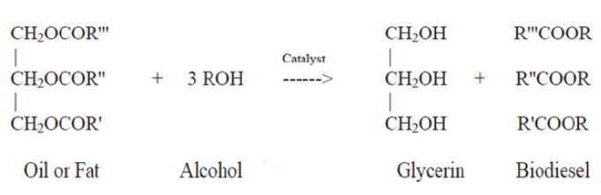
Biodiesel
Biodiesel is a liquid biofuel obtained by chemical processes from vegetable oils or animal fats and an alcohol that can be used in diesel engines, alone or blended with diesel oil
Biodiesel is an alternative energy source and could be a substitute for petroleum-based diesel fuel.
The production of biodiesel chemical reaction is known as transesterification.
Transesterification is the chemical process, which converts natural fats and oils into Biodiesel. Most of the biodiesel is produced from waste animal fats and vegetable oils obtained from restaurants, and industrial food producers.

Slide 43
Advantages of the Use of Biodiesel:
Some of the advantages of using biodiesel as a replacement for diesel fuel are Renewable fuel, obtained from vegetable oils or animal fats.
Low toxicity, in comparison with diesel fuel. ✓ Degrades more rapidly than diesel fuel, minimizing the environmental consequences of biofuel spills.
Lower emissions of contaminants: carbon monoxide, particulate matter, polycyclic aromatic hydrocarbons, aldehydes.
Lower health risk, due to reduced emissions of carcinogenic substances. ✓ No sulfur dioxide (SO2) emissions.
Higher flash point (100C minimum).
May be blended with diesel fuel at any proportion; both fuels may be mixed during the fuel supply to vehicles.
Excellent properties as a lubricant.
It is the only alternative fuel that can be used in a conventional diesel engine, without modifications.

Slide 44
Disadvantages of the Use of Biodiesel
Slightly higher fuel consumption due to the lower calorific value of biodiesel.
Slightly higher nitrous oxide (NOx) emissions than diesel fuel.
Higher freezing point than diesel fuel. This may be inconvenient in cold climates.
It is less stable than diesel fuel, and therefore long-term storage (more than six months) of biodiesel is not recommended.
It may degrade plastic and natural rubber gaskets and hoses when used in pure form, in which case replacement with Teflon components is recommended.
In consequence, the cleaning of tanks prior to filling with biodiesel is recommended.
It must be noted that these disadvantages are significantly reduced when biodiesel is used in blends with diesel fuel.

Slide 45
SECONDARY BATTERIES

Slide 46
INTRODUCTION
Rechargeable batteries (also known as secondary cells) are batteries that potentially consist of reversible cell reactions that allow them to recharge, or regain their cell potential, through the work done by passing currents of electricity.

Slide 47
working
Rechargeable (or secondary) batteries contain active materials that can be regenerated by charging. All batteries have positive and negative terminals, marked (+) and (-) respectively, and two corresponding electrodes. The electrodes must not touch each other, and are separated by the electrolyte, which facilitates the flow of electric charge between the electrodes. A collector conducts the charge to the battery's exterior and through the load.

Slide 48
When a battery is inserted into an electrical device, the device completes the circuit between the two terminals and triggers electrochemical reactions within the battery. The anode undergoes an oxidation reaction with the electrolyte and releases electrons, while the cathode undergoes a reduction reaction and absorbs the free electrons. The product of these two reactions is electricity, which is channeled out of the battery and into the device.

Slide 49
When a secondary battery is recharged, its electrodes undergo an opposite process to the discharging action described above. As the battery charger passes electricity through the battery, its cathode is oxidized and produces electrons which are then absorbed by the anode. When the battery is fully charged, it can be connected to a load and discharged again.

Slide 50
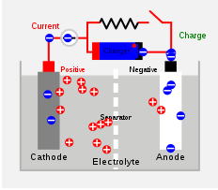
Working(charging)

Slide 51
lead–acid battery
nickel–cadmium battery
Types Of Secondary Batteries
lithium-ion battery

Slide 52
1.Lead acid Batteries

Slide 53
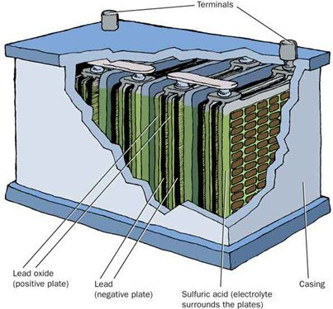
1 Chemistry of a Lead Acid Battery
2 Composition of a Lead Acid Battery Positive Plate: Lead Oxide (PbO)
Negative Plate: Lead (Pb)
Electrolyte: sulphuric acid (H2SO4)
3 Review of Acid Terminology Strong vs. Weak Acids
Strong acids completely ionize in water
EX: HCl → H+ + Cl- (HCl + H2O → H3O+ + Cl-)
Weak acids partially ionize in water
EX: HC2H3O2 ⇌ H+ + C2H3O2-
(note ⇌ versus ) Monoprotic vs. Diprotic Acids
Monoprotic acid has one H+ (EX: HCl)
Diprotic acid has two H+ (EX: H2SO4)

Slide 54
4 The Electrolyte: H2SO4
H2SO4 is classified as a strong acid (completely ionizes) but that is not exactly true. The first ionization of H2SO4 is complete and occurs instantly when in water.
EX: H2SO4 → H+ + HSO4-
But! The second ionization is extremely partial.
EX: HSO4- ⇌ H+ + SO4-2 (Ka = 0.012!)
This is very important in understanding the chemistry of a lead acid battery!
5 for understanding
In general, is sulfuric acid considered a strong or weak acid?
Strong- Why is sulfuric acid considered to be strong?
It completely ionizes
What ion related to sulfuric acid is weak?
HSO4̶- Why is the bisulfate ion, HSO4̶ considered weak?
It partially ionizes

Slide 55
6 Lead Acid Batteries are rechargeable This leads to two different sets of redox reactions.
The discharging phase. The charging phase.
7 Chemistry of Discharge Phase Negative plate reaction (oxidation):
Pb + HSO4̶ → PbSO4 + H e̶
Positive plate reaction (reduction):
PbO2 + HSO4̶ + 3H+ + 2e- → PbSO4 + 2H2O
Overall discharge redox reaction:
Pb + PbO2 + 2 HSO4̶ + 2H+ → 2 PbSO4 + 2H2O
or…Pb + PbO2 + 2 H2SO4 → 2 PbSO4 + 2H2O
Note: states are removed for simplicity
Pb, PbO2, and PbSO4 are always solids
HSO4-, H+, and H2SO4 are always aqueous
H2O is always a liquid

Slide 56
8 The flow of electrons = ELECTRICITY!
9 Chemistry of Charge Phase Negative plate reaction (reduction):
PbSO4 + H e- → Pb + HSO4̶
Positive plate reaction (oxidation):
PbSO4 + 2H2O → PbO2 + HSO4̶ H+ + 2e-
Overall charge redox reaction:
2 PbSO4 + 2H2O → Pb + PbO2 + 2 HSO4̶ + 2H+
or…2 PbSO4 + 2H2O → Pb + PbO2 + 2 H2SO4
10 for understanding
What metal is always at the negative plate? Pb
What compound is always at the positive plate? PbO2
What is the electrolyte in a battery? H2SO4 or HSO4̶
What compound is the “waste” product of discharge and has to be removed in the charging process? (think!) PbSO4

Slide 57
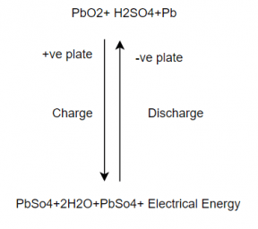
The combined equation for both the processes is represented as
11 Why do batteries “die”?
Dead Battery
New Battery When the battery discharges solid PbSO4 is formed.
In a new battery, the PbSO4 is in a spongy form which can easily be converted back to Pb and PbO2.
Over time the PbSO4 will tend to crystallize.
The crystallized PbSO4 cannot be converted back to Pb and PbO2 so there is not only less reactant material but it also coats the surface of the Pb and PbO2.
New Battery
Dead Battery

Slide 58
Life
The optimum functional temperature for lead acid battery is 25⁰C which means 77⁰F. The increase in the range of temperature shortens longevity. A per the rule, for every 80oC increase in temperature, it reduces the half-life of the battery. While a value regulated battery that functions at 25⁰C has a lead acid battery life of 10 years. And when this is operated at 33⁰C, it has a life period of 5 years only.
Lead Acid Battery Applications
These are employed in emergency lightening to provide power for sump pumps.
Used in electric motors
Submarines
Nuclear submarines

Slide 59
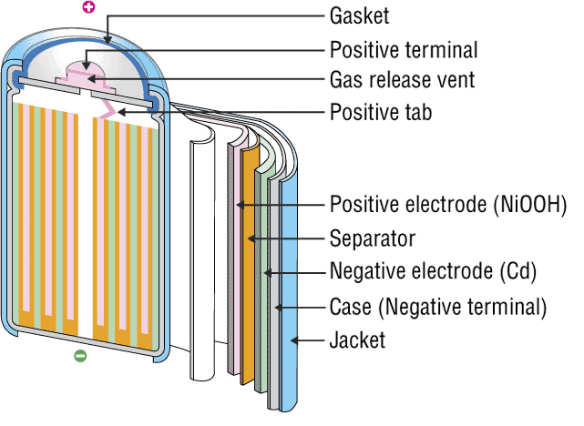
INTRODUCTION
2. NICKEL-CADMIUM BATTERY
The nickel–cadmium battery is a type of rechargeable battery using nickel oxide hydroxide and metallic cadmium as electrodes. Ni-Cd batteries are made in a wide range of sizes and capacities.
Nickel(hydroxide)–cadmium systems are the most common small rechargeable battery type for portable appliances. The sealed cells are equipped with “jelly roll” electrodes, which allow high current to be delivered in an efficient way. These batteries are capable of delivering exceptionally high currents, can be rapidly recharged hundreds of times, and are tolerant of abuse such as over discharging or overcharging.
It produces a voltage of about 1.4 V

Slide 60
INVENTIONS AND SCOPE
Nickel-cadmium (NiCd)
Invented by Waldemar Jungner in 1899. Developments were slow, but in 1932, advancements were made to deposit the active materials inside a porous nickel-plated electrode. Further improvements occurred in 1947 by absorbing the gases generated during charge, which led to the modern sealed NiCd battery.
For many years, NiCd was the preferred battery choice for two-way radios, emergency medical equipment, professional video cameras and power tools. In the late 1980s, the ultra-high capacity NiCd rocked the world with capacities that were up to 60 percent higher than the standard NiCd.
Since the disposal of battery is hazardous to environment alternative cells are being used such as paper battery

Slide 61
RECENT TRENDS
The primary trade-off with Ni–Cd batteries is their higher cost and the use of cadmium. This heavy metal is an environmental hazard, and is highly toxic to all higher forms of batteries.
Recently, nickel–metal hydride and lithium-ion batteries have become commercially available and cheaper, the former type now rivalling Ni–Cd batteries in cost..
The batteries are more difficult to damage than other batteries, tolerating deep discharge for long periods.
Ni–Cd batteries typically last longer, in terms of number of charge/discharge cycles, than other rechargeable batteries such as lead/acid batteries.
Compared to lead–acid batteries, Ni–Cd batteries have a much higher energy density.
In consumer applications, Ni–Cd batteries compete directly with alkaline batteries. A Ni–Cd cell has a lower capacity than that of an equivalent alkaline cell, and costs more.
The capacity of a Ni–Cd battery is not significantly affected by very high discharge currents.

Slide 62
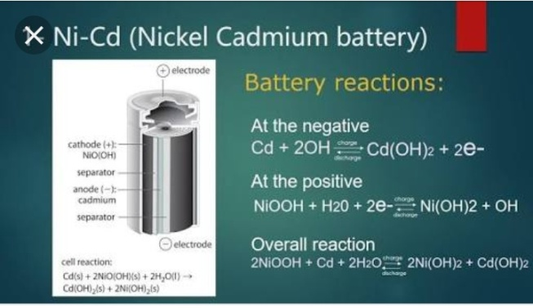
CELL REPRESENTATION AND CELL REACTION
A typical Ni-Cd battery is represented as
Cd| Cd(OH)2|| NiO(OH)| Ni(OH)2
Cell reaction while discharging
At Anode: oxidation of Cd metal
Cd + 2OH_ Cd(OH)₂ + 2e⁻
At cathode: reduction of NiO(OH)
2NiO(OH) + 2H₂O + 2e⁻ 2Ni(OH)₂ + 2OH⁻
Net Cell reaction:
2NiO(OH) + 2H₂O + Cd 2Ni(OH)₂ + Cd(OH)₂

Slide 63
ADVANTAGES
Fast and simple charging process
It is compact and lighter than traditional batteries
It has a longer life than lead storage batteries
Available in a wide range of sizes and performance options
Good low-temperature performance
Only battery that can be ultra-fast charged with little stress

Slide 64
LIMITATIONS
It is rather more expensive than a lead storage battery
It has a lower energy density value
Cadmium is a toxic metal. Cannot be disposed of in landfills
Memory effect; needs periodic full discharges
High self-discharge; needs recharging after storage

Slide 65

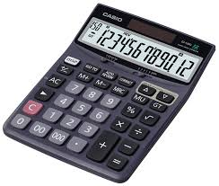


APPLICATIONS
Ni-Cd cells are popularly used in many appliances because they are available in variety of sizes and capacities.
Few examples are:
Calculators
Electronic flash units
Transistors
Cordless appliances

Slide 66
3. RECHARGEABLE LITHIUM Batteries

Slide 67
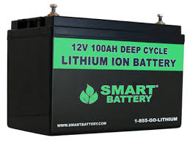
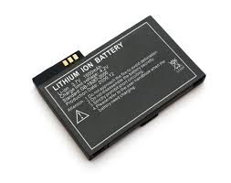
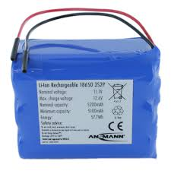
DESCRIPTION
A lithium-ion battery or Li-ion battery (abbreviated as LIB) is a type of rechargeable battery in which lithium ions move from the negative electrode to the positive electrode during discharge and back when charging.
The electrolyte, which allows for ionic movement, and the two electrodes are the constituent components of a lithium-ion battery cell.

Slide 68

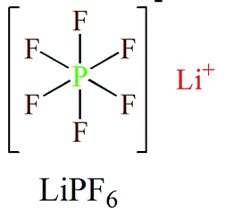
Electrolytes
Role-
Ion conduction between cathode and anode.
They are generally, Lithium salts dissolved in organic solvent.
Commercial electrolytes: in Carbonate solvent.

Slide 69
Anode Materials
Requirements:
Large capabilities of adsorption.
High efficiency of charge/discharge.
Low reactivity against electrolyte.
Fast reaction rate.
Low cost
Environment friendly
Commercial anode materials:
Hard Carbon, Graphite

Slide 70
Cathode Materials
Requirements:
A high discharge voltage
A high energy capacity
A high power density
Light weight
Low self discharge
Environment friendly
Commercial cathode materials:
LiCoO2, LiFePO4 etc.

Slide 71
Chemical Reactions
Main essential components...
Anode: Graphite [carbon] - C(s)
Cathode: Lithium Cobalt Oxide - LiCoO2
Electrolyte: Typically a combination of lithium salts - LiPF6, LiBF4, or LiClO4, in an organic solvent, such as either.
Separator: The separator is a very thin sheet of micro perforated plastic. - CH2=CHCl

Slide 72
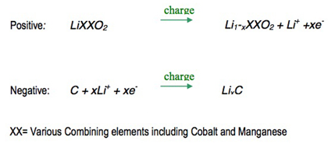
Reactions while charging
On charge the positive electrode, cathode, material is oxidized, Li+ ions are de-intercalated from the layered lithium LiCoO2, pass across the electrolyte and are intercalated between the graphite layers in graphite by an electrochemical reduction reaction proceeding at the negative electrode.

Slide 73
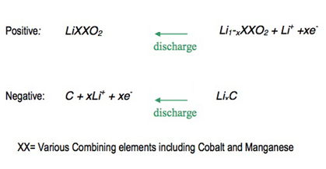
Reactions while discharging
When the cell is discharged, an oxidation reaction occurs at the negative electrode, Li+ ions are de-intercalated from the anode and migrate across the electrolyte to be re-intercalated into the cathode material, due to charge balance the equivalent number of electrons travel through the external circuit. A simultaneous electrochemical reduction reaction proceeds at the positive electrode and accepts electrons from the external circuit, Li+ ions from the electrolyte, to reform the starting material. A change from electronic current to ionic current occurs at the electrode/electrolyte interface.

Slide 74
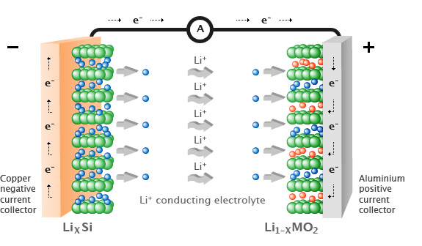
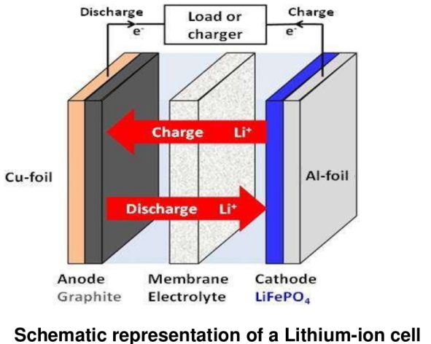


Slide 75
Applications
Emergency Power Backup Or UPS
Dependable Electric And Recreational Vehicle Power
Solar Power Storage
Reliable And Lightweight Marine Performance
Solar Power Storage
Surveillance Or Alarm Systems In Remote Locations
Personal Freedom With Mobility Equipment
Portable Power Packs That Eliminate Downtime

Slide 76
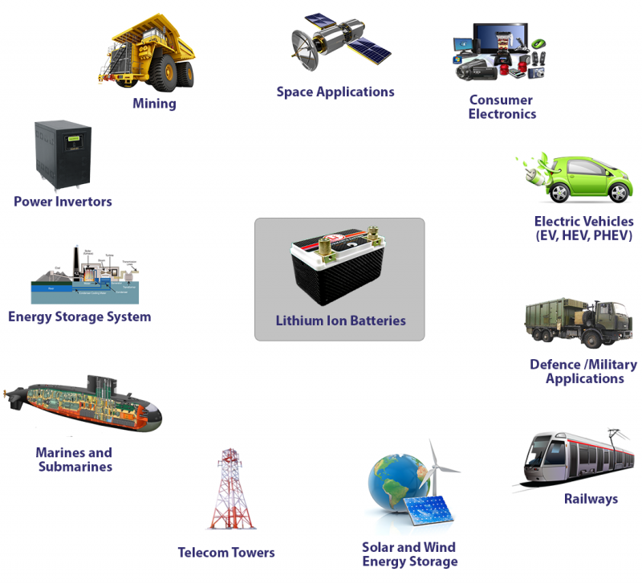

Slide 77
Waste to energy conversion

Slide 78

Waste to Energy
The increasing industrialization, urbanization and changes in the pattern of life give rise to generation of increasing quantities of wastes.
Scarcity of fossil fuels particularly petroleum crude is forcing us to develop some clean technology for the utilization of the fossil fuels as well as to utilize renewal resources.
In recent years, technologies have been developed that not only help in generating substantial quantity of decentralized energy but also in reducing the quantity of waste for its safe disposal.

Slide 79
Types of waste
There are different types of waste which are generated from our daily or industrial activities such as organic waste, e-waste, hazardous waste, inert waste etc.
Organic waste refers to waste which degrades or broken down by microorganisms over time. All organic wastes are essentially carbon based compounds.
Organic waste has significant portion in overall waste generation in industrial/urban/ agricultural sector and therefore it can be used for energy generation.

Slide 80
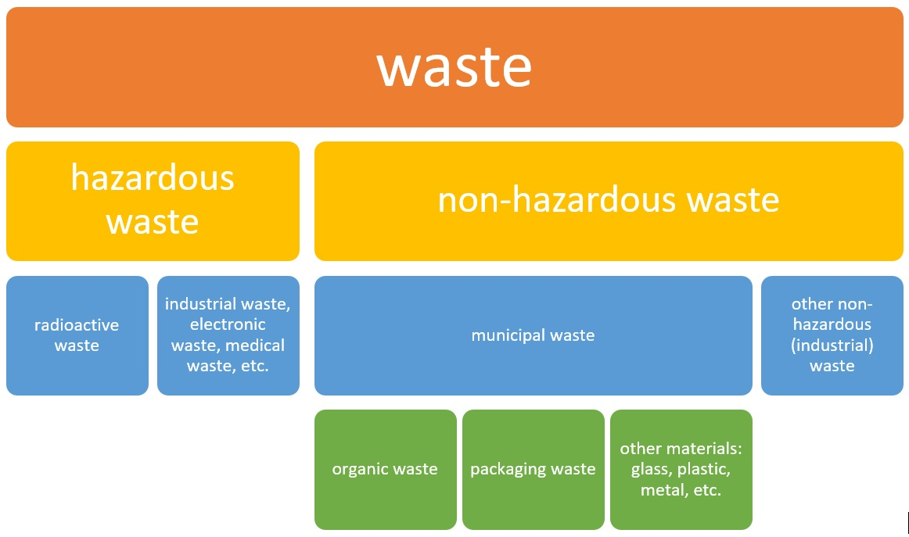

Slide 81
Important Parameters of different types of waste
Solid Waste | Waste Water | Waste Gas
Elemental Composition C, H, N, O & S | BOD & TOC | Particulate Matter
Moisture, Volatile & Ash content | pH, | Nox, Sox and CO
Bulk Density, | TDS and TSS | Heavy metal ions
Heating Value | Cations and anions | Hydrocarbon and other fuel
Hence the factors like Carbon content of solid waste , BOD and sludge content of liquid fuels and Combustible gas content of gaseous waste are important parameters for converting waste in to energy.

Slide 82
Composition of Municipal Waste

Slide 83
Need for energy production from waste
Waste to energy conversion gives the following advantages
1) It meets some energy demand, on the other way it gives some a systematic solid waste management system.
2) It helps us to achieve the sustainability goal of the society,
3) Decrease in production of green house gases
4) Reduction of dependance on fossils fuels
5) Waste to energy technology converts municipal waste into electric, heat and fuels
6) Reduction of waste going to land fills

Slide 84
Methods of production of energy from waste
1. Incineration: incineration is a waste treatment process that involves the combustion of organic substances content in waste materials
2. Gasification: gasification is a process that converts carbonaceous feedstocks into combustible gasses including H₂ and CO mainly carbon monoxide and hydrogen dioxide gas.
3. Pyrolysis: pyro means fire, lysis means cutting. So, this is the process that is thermal decomposition process which decomposes carbonaceous material by the application of heat in absence of oxygen.
4. Anerobic Digestion: In an oxygen-free tank, this material is broken down to biogas and fertilizer.
In incineration we used excess amount of oxygen in gasification we use controlled amount of oxygen and in pyrolysis we use no oxygen theoretically.

Slide 85
E-waste
Electronic waste or E-waste describes the discarded electrical or electronic devices.
Sources of e-waste
Waste produced due to data generating & processing devices like computers, monitors, speakers, keyboards, printers etc.
Electronic devices used in TV, DVDs and CDs.
Equipment's used in communication like phones, landlines phones, mobiles etc.
Household equipment like vacuum cleaner, microwave ovens, washing machines, air conditioners etc

Slide 86
Effect of e-waste on environment
Emission from e-waste create environmental damage
Toxic chemicals from e-waste enter into soil-crop-food pathway.
They are non-biodegradable causing pollution of soil
E-waste dumping yards causes pollution and health hazards.
It cause health hazards due to lead, mercury, cadmium poisoning

Slide 87
E-wate management
Common methods
Landfill disposal
Incineration
Acid treatment
Advanced method
Recycling
It involves
Disassembling-carefully separating various components
Upgrading-involves mechanical or chemical or metallurgical methods to recover the metals
Glass, plastic, metals can be recovered and then mixed with other ingredients to produced many valuable recycled products.

Slide 88
Thank you

